Slide 1





MACHINE LEARNING IN ENGINEERING SCIENCE
Music Genre Generation System
Start!
Group 12
E94101096劉翁碩
P86131183官廷昱
N16131722許志煒
N96131558林沛錡

Slide 2



Outline
1
2
3
4
Introduction
Method
Results
Conclusions

Slide 3
Introduction

Slide 4
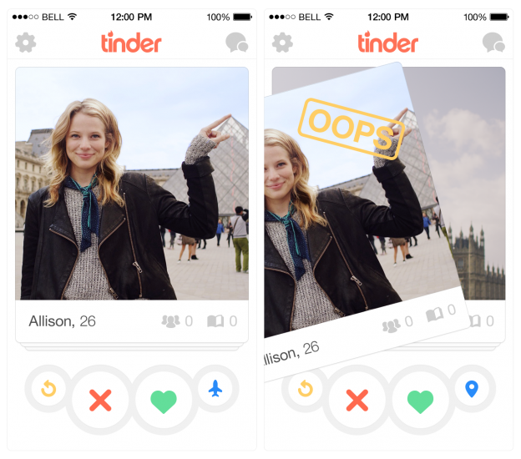
Background
In today's age of information overload and endless choices, we are often overwhelmed by a flood of songs, yet we are unsure of what we truly like or are limited to the music we’ve already heard.
The process of discovering new music is often challenging. Although many music platforms allow us to browse and search endlessly, inspiration usually comes from a simple choice. Just like how Tinder simplifies the matching process by allowing users to like or dislike, music discovery should also be made more intuitive and effortless.
Notes:
在這個資訊過載、選擇無窮的時代，我們常常被琳瑯滿目的歌曲所淹沒，卻仍然不知該聽哪首。
同時，Tinder 透過其基於滑動的互動方式，讓尋找配對變得簡單直覺。
我們不禁思考：如果將同樣的互動模式應用於音樂發現，會怎麼樣？

Slide 5

Background
This simple idea inspired us to create 聽der — a name that combines the Chinese word for “listen” - “聽” with the familiar experience of Tinder.
In 聽der, all choices can be made with a simple click.You only need to select your current mood and music genre. Then, based on your selection, the system will guide you to quickly choose your favorite music style.
聽der makes music discovery no longer about opening a playlist and listening to the same type of music. Instead, it’s an interactive journey where, with each choice you make, the system automatically builds a personalized music playlist for you. From now on, music no longer needs to be found by you — it will naturally find you. Just like Tinder, the perfect music style is waiting for you with just one choice.
.
Start!
Notes:
這個簡單的想法啟發我們創造了「聽der」——這個名字將中文「聽」與Tinder的熟悉體驗相結合。「聽der」是一款基於滑動的音樂發現應用，用戶只需一個手勢即可瀏覽短歌片段——向左滑動跳過，向右滑動點讚。根據您的選擇，系統會學習您的偏好，並自動建立個人化的歌單，其中包含您可能喜歡的歌曲，可供播放或下載。有了“聽der”，聆聽不再只是被動地流媒體音樂——它變成了一段連接彼此的旅程，一個愛上從未想過自己需要的音樂的機會。因為有時候，完美的歌曲無需尋找。它會找到您——就像在Tinder上找到匹配對像一樣。

Slide 6
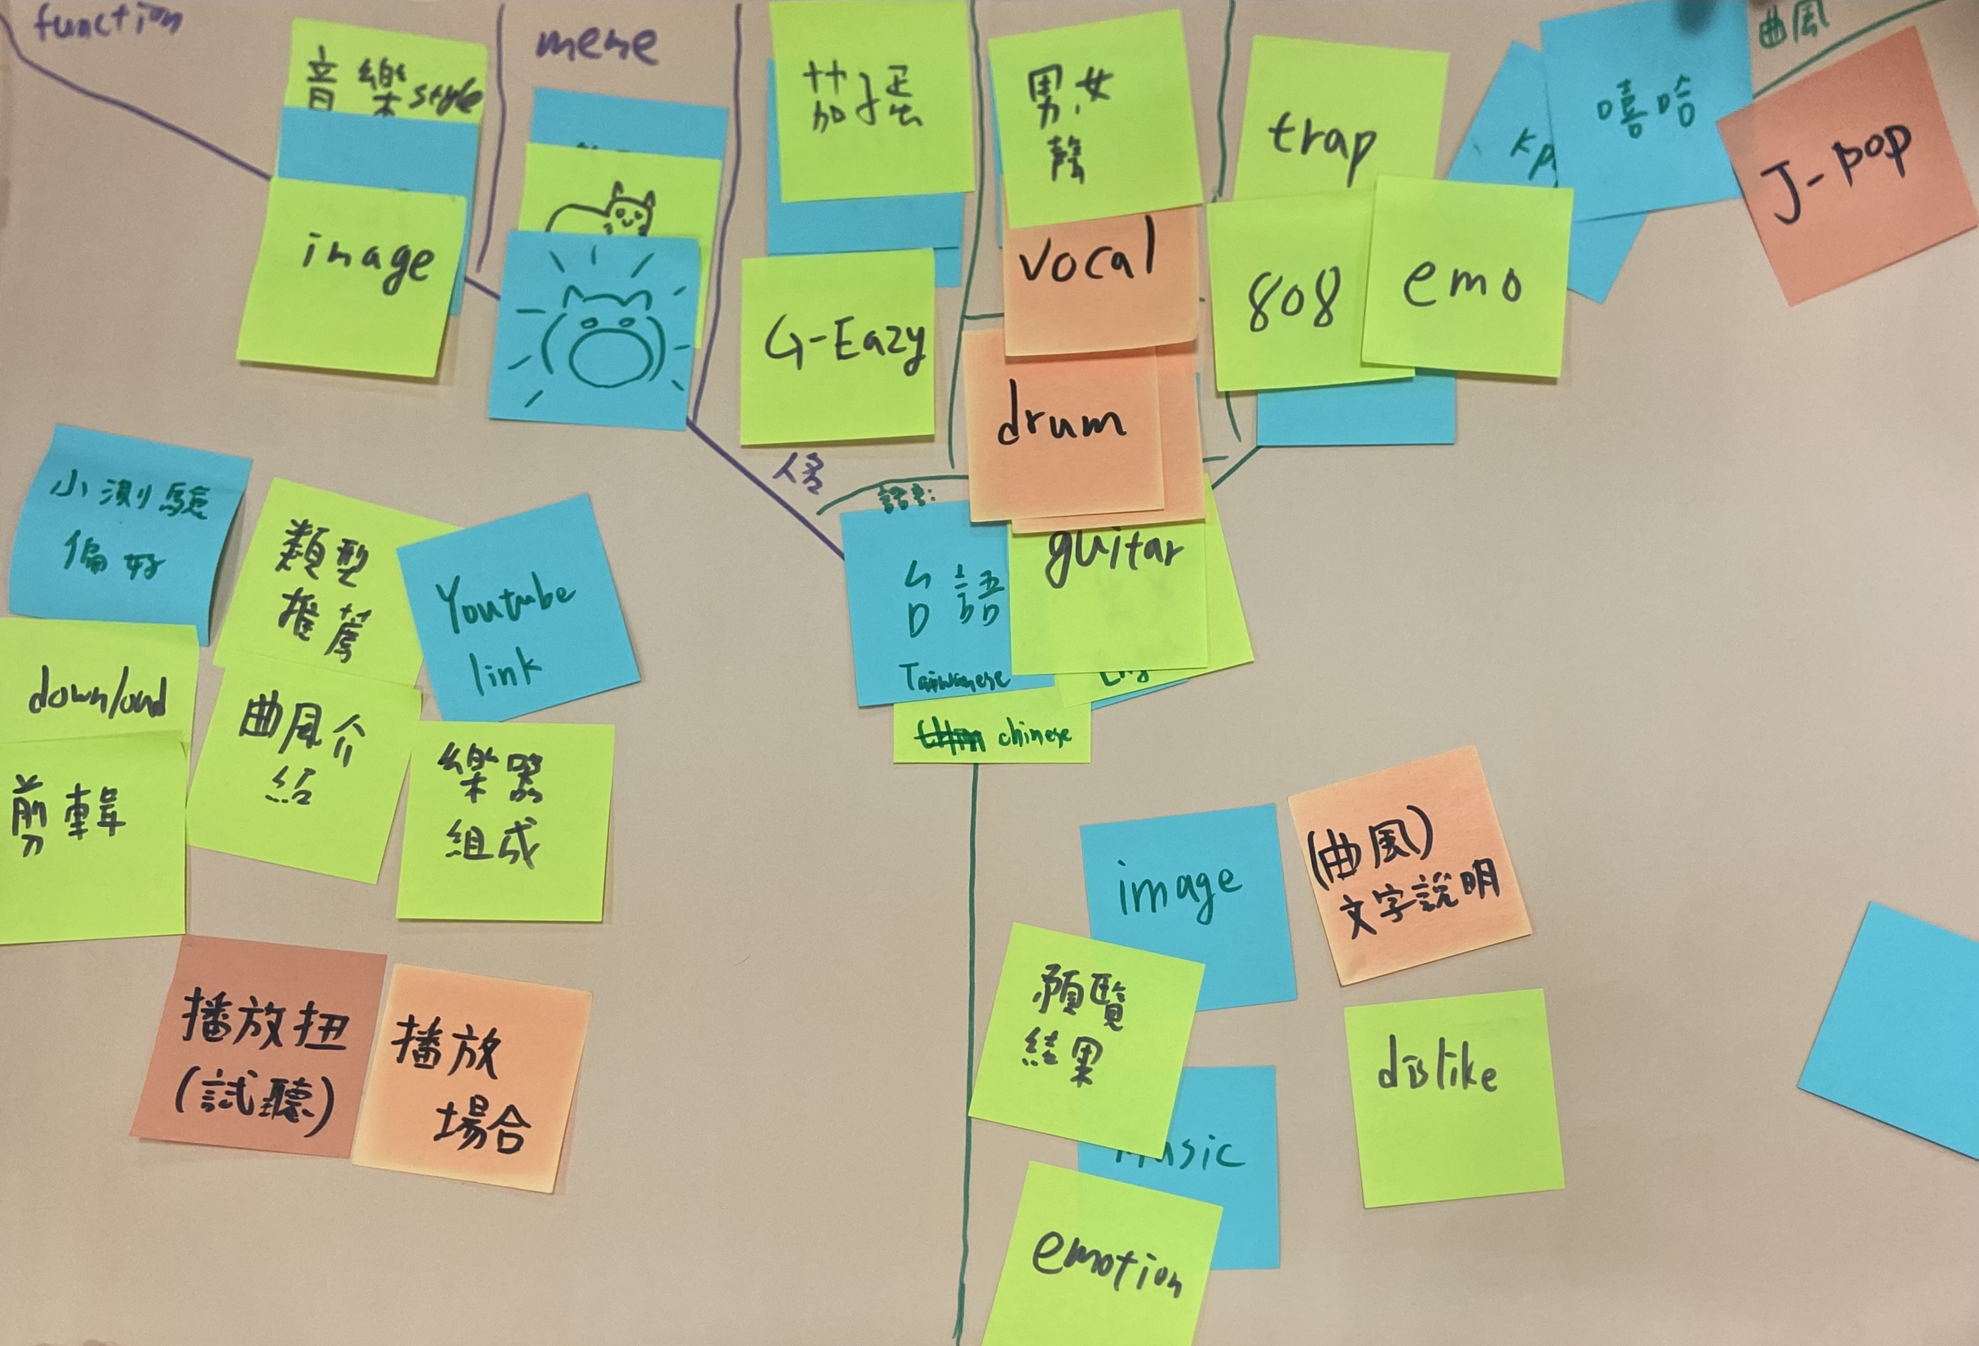
Workshop

Slide 7
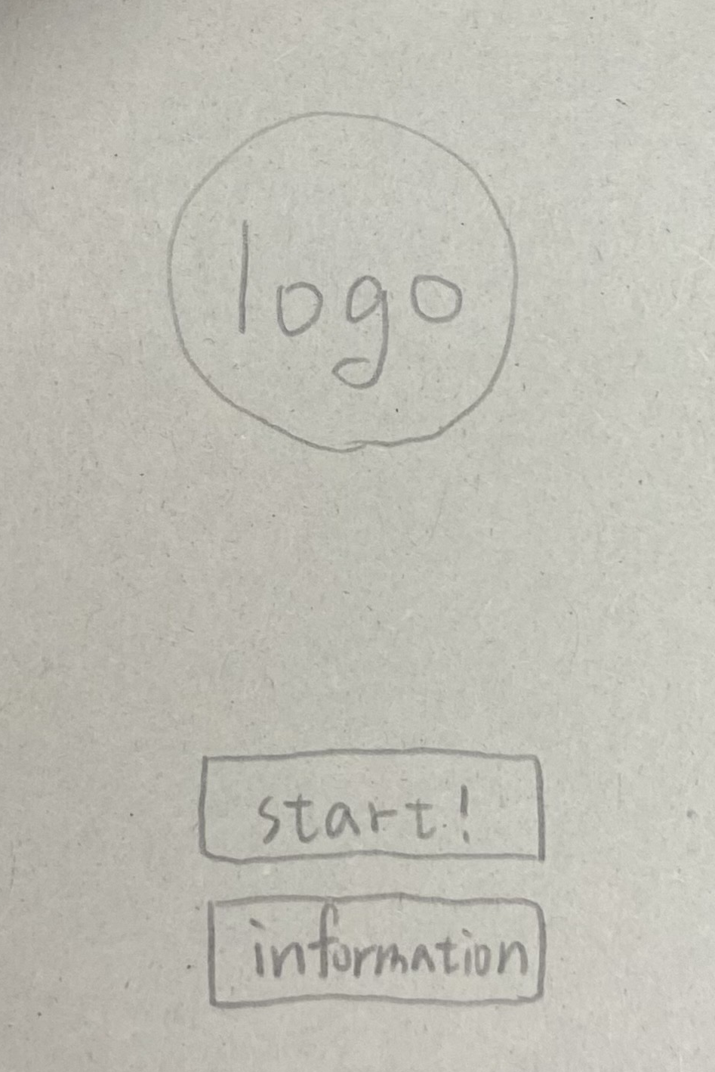
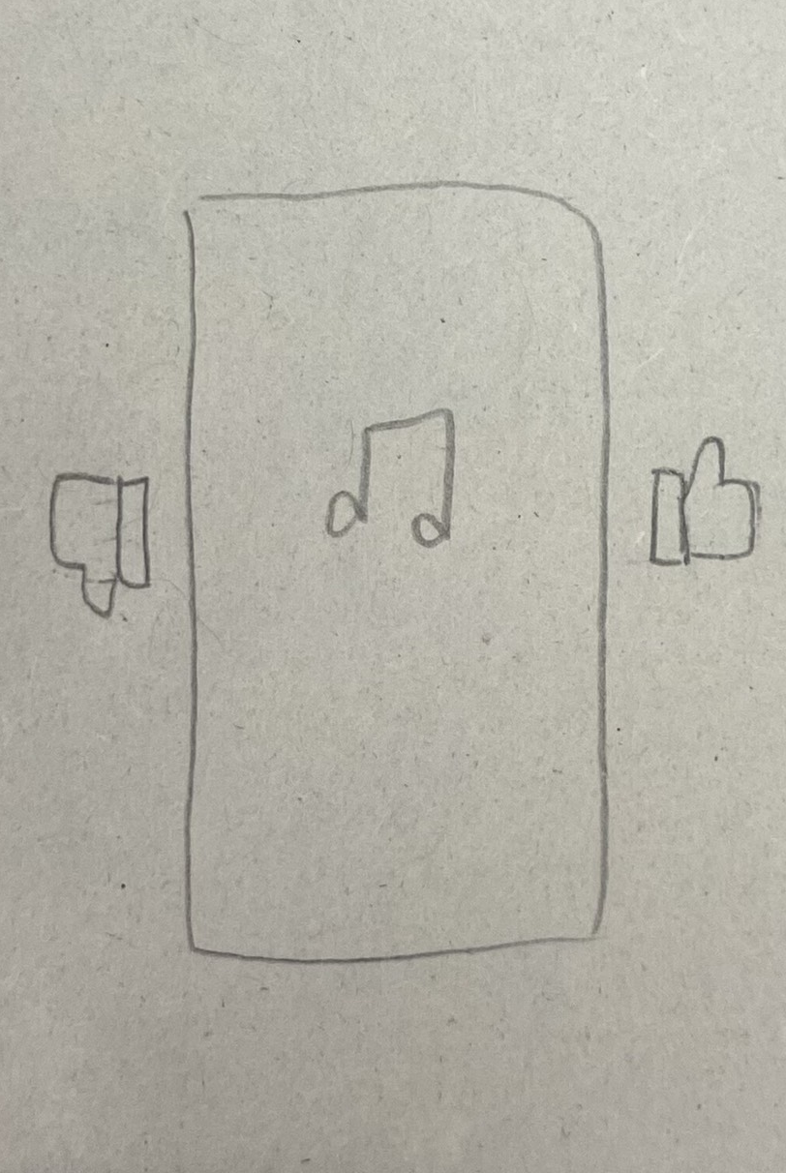
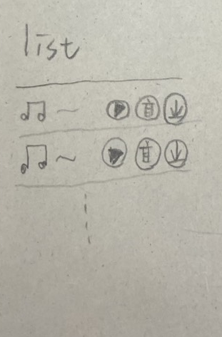
Workshop
Group 12:
Our program is called 聽der music
We are addressing a real-world issue related to decision fatigue in music selection due to overwhelming content choices.
We decompose the issue into several components such as user preference identification, swipe-based interaction, recommendation generation, and personalized playlist creation.
We map to user behavior inputs and feedback through the Al program’s recommendation system.
The goal of the Al program is to allow users to explore music in a fun, intuitive way and effortlessly connect with songs that truly match their personal taste.
Interaction Screen
Interaction Screen
Interaction Screen

Slide 8
Method

Slide 9
Data preprocessing
Audio (.wav)
CNN-ready Data
(Train / Validation / Test)
Cut into 2-second segments
Normalization → Split →
One-hot Encoding → Reshape
Segmented audio
extract_features()
Load into X, y
Save as .pkl file
Extract Mel + Chroma + MFCC → (1, 173, 89, 1)
All feature files

Slide 10

Generate model
Use the “ facebook/musicgen-small ” music generation API from Hugging Face. By entering your desired music genre and style into the prompt, you can automatically generate corresponding music.
Reference Link: https://github.com/huggingface/transformers

Slide 11
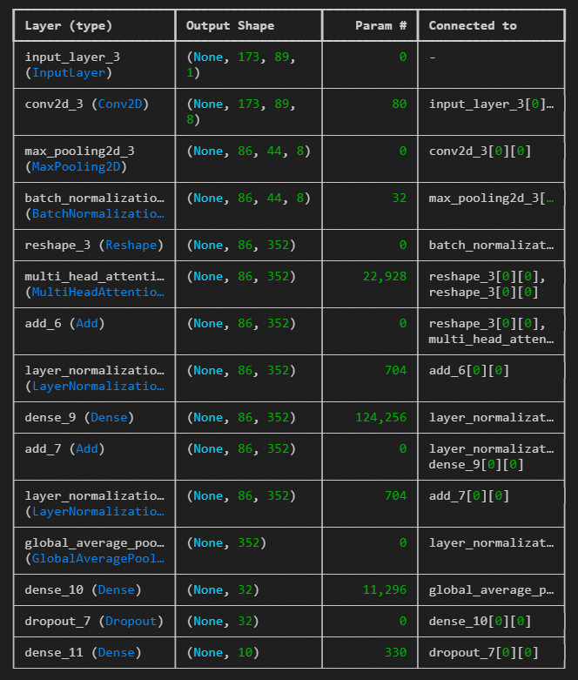
Model architecture
s

Slide 12
Result

Slide 13
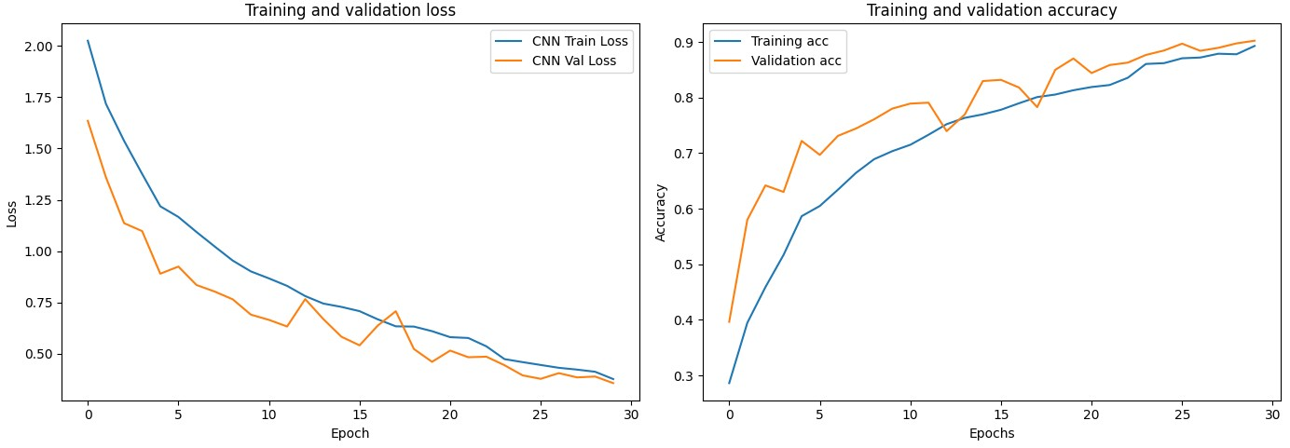
Training results
Split the dataset：training 75%, validation 12.5%, test 12.5%.
Test Accuracy(CNN):0.9082
Test Loss(CNN):0.3508

Slide 14
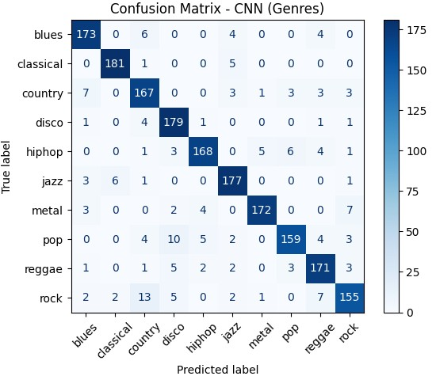
Training results

Slide 15
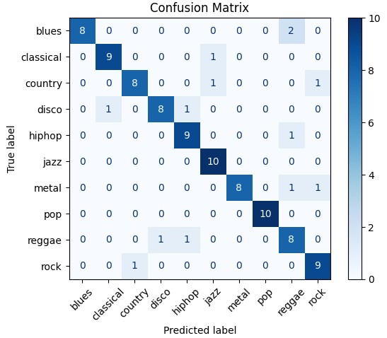
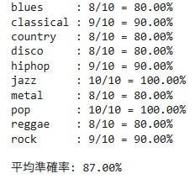
Classification results
Classification accuracy: 87.00%
Confusion matrix of the classification model

Slide 16
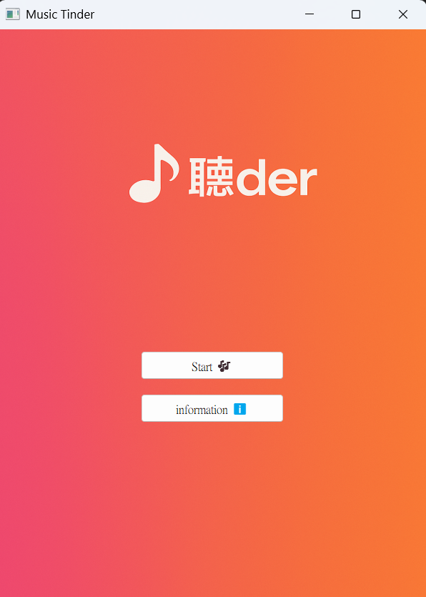
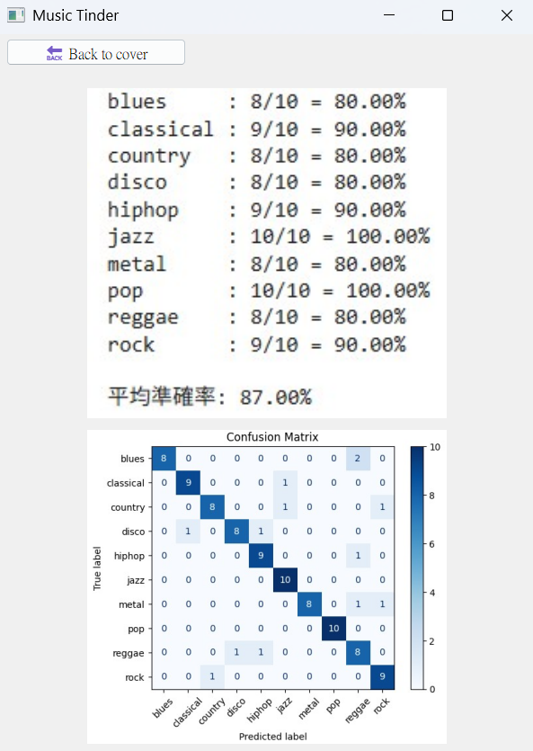

GUI Interface
Information
Initial screen
Classiification result

Slide 17
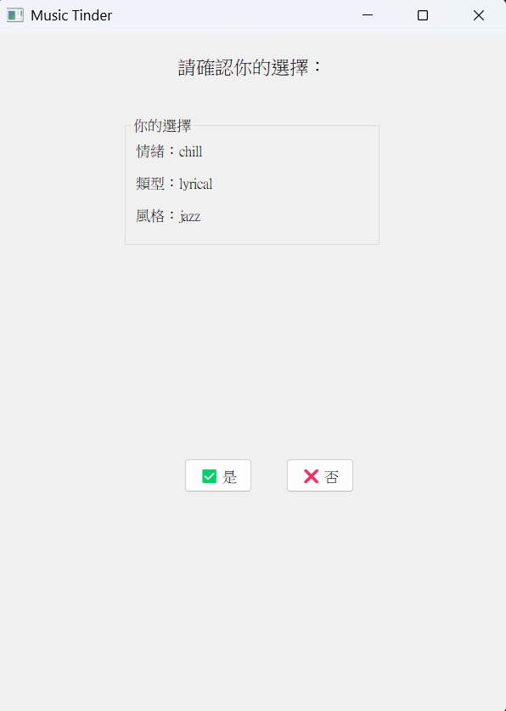
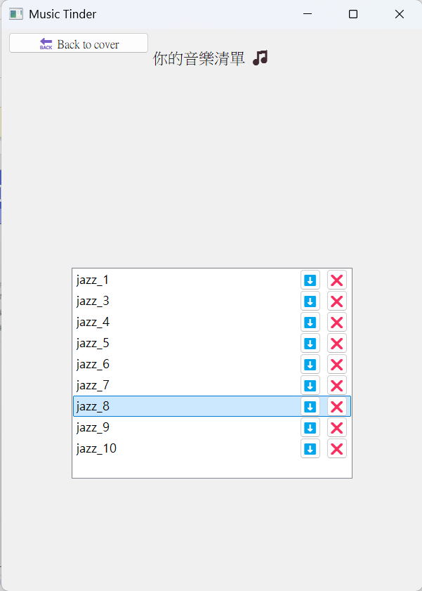
GUI Interface
Your choice
Music list

Slide 18

Operation video
Github link:
https://github.com/AndyXu66/MLfinal.git
Youtube link:
https://youtube.com/shorts/zYSYSVqA7Ic?feature=share

Slide 19
Conclusions

Slide 20
Conclusions
We’re pleased with the model’s performance: on a ten-genre music classification task, it achieved an average accuracy of 87%, and the confusion matrix demonstrates strong class-separation. To further improve, you might consider:
Incorporating traditional ML algorithms
Compare with ensemble methods such as Random Forest and XGBoost alongside your CNN to identify the best approach.
Enhancing feature engineering
In addition to Mel-spectrograms, extract features like MFCCs, chroma vectors, and tonnetz to enrich the input representation.
Model ensembling and hyperparameter tuning
Use ensemble strategies (e.g. soft-voting or weighted voting) and systematic hyperparameter searches (grid search or Bayesian optimization) to leverage complementary model strengths.
Expanding and augmenting the dataset
Add more diverse, longer audio samples or apply augmentation techniques (pitch shifting, time stretching, etc.) to boost generalization.
Implementing these steps should help you achieve higher accuracy and more robust performance in music genre classification.

Slide 21
Work Allocation
E94101096
劉翁碩
N16131722
許志煒
P86131183
官廷昱
N96131558
林沛錡
Model Training Code
Presentation Preparation
Model Training Code
Presentation Preparation
UI Design
Presentation Preparation
UI Design
Presentation Preparation

Slide 22



Thank
you

